Slide 1
Gene Expression Profiling & Treatment Outcomes in ER+ Breast Cancer Patients:
A Comparative Study of Tamoxifen and Adjunct Therapies
Lindsey Tucker, Gayathri Dhurjati

Slide 2
Background
ER+ Breast Cancer and Cancer Therapeutics

Slide 3
Background: Breast Cancer Types
Breast cancer classification based on cancer cell receptors
Estrogen receptor (ER)
Progesterone receptor (PR)
Human epidermal growth factor receptor 2 (HER2)
Hormone dependent breast cancer (ER+ and/or PR+)
70%-90% of diagnosed breast cancer
Anti-hormone treatment targets hormone receptors
1 out of 3 patients develop resistance to hormonal therapy
Also, HER2+ (ER-/PR-) and triple negative (ER-/PR-/HER2-) tumor types

Slide 4
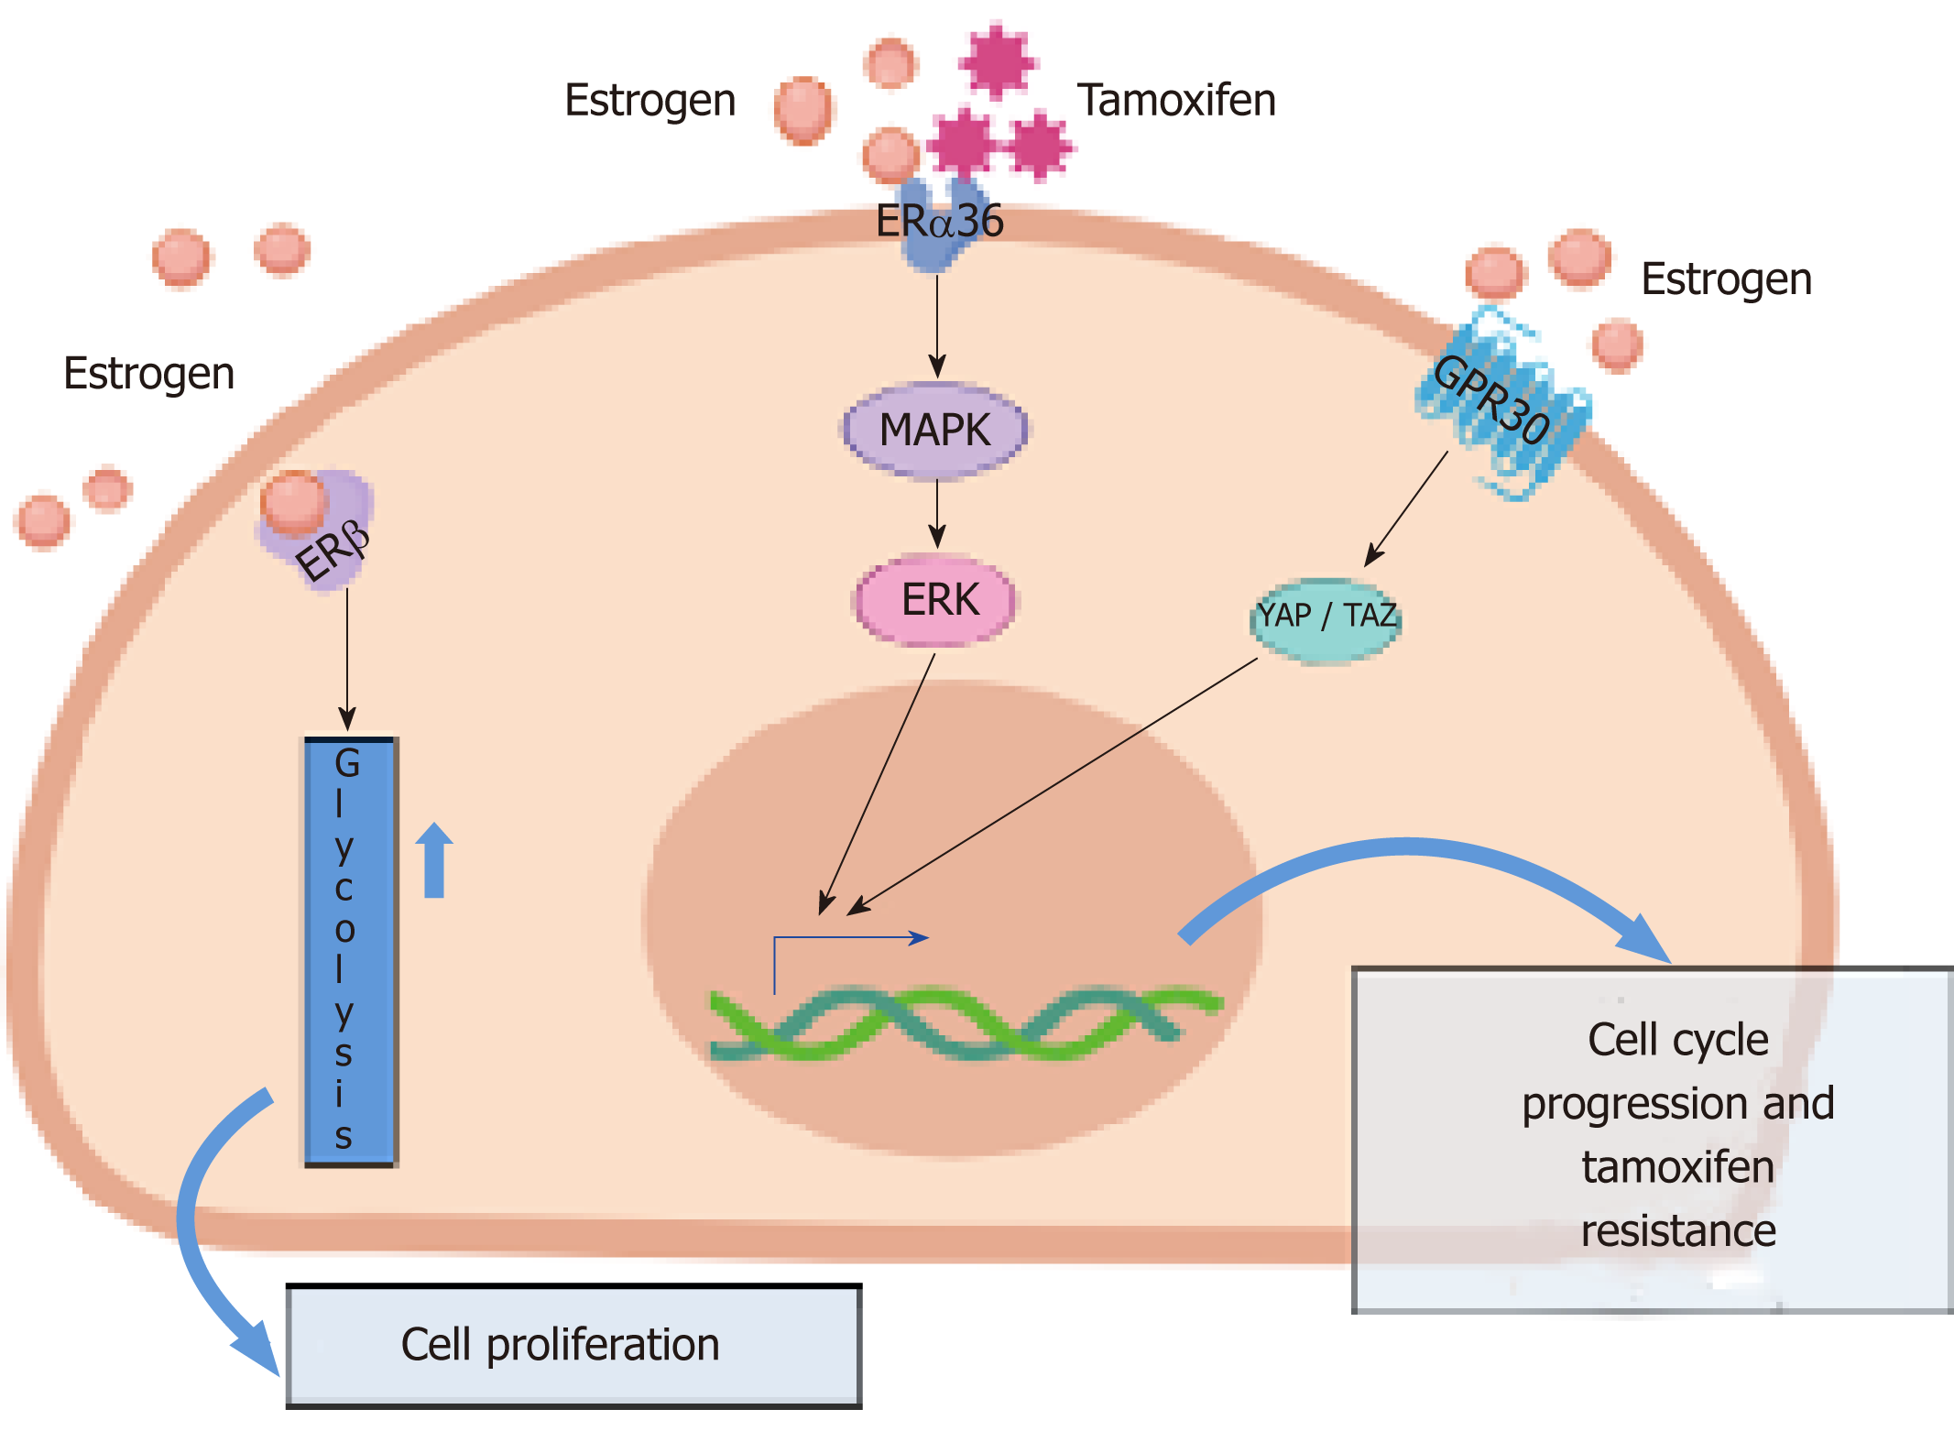
Background: Cancer Therapeutics
Chemotherapy
Cytotoxic drugs to arrest cell growth
Radiotherapy
Uses radiation to kill cancer cells and shrink tumors
Hormone therapy
Targeted therapy
Binds to receptors specific to hormone dependent BC
Tamoxifen

Slide 5
Dataset
Curated datasets from Gene Expression Omnibus (GEO) studies

Slide 6
Dataset
Curated breast cancer dataset from Gene Expression Omnibus (GEO)
R package available from Bioconductor: library(curatedBreastData)
Clinical data table
Study ID, patient ID, relapse free survival, age, tumor histology grade, treatment data
Microarray
Patient gene expression levels for each study

Slide 7
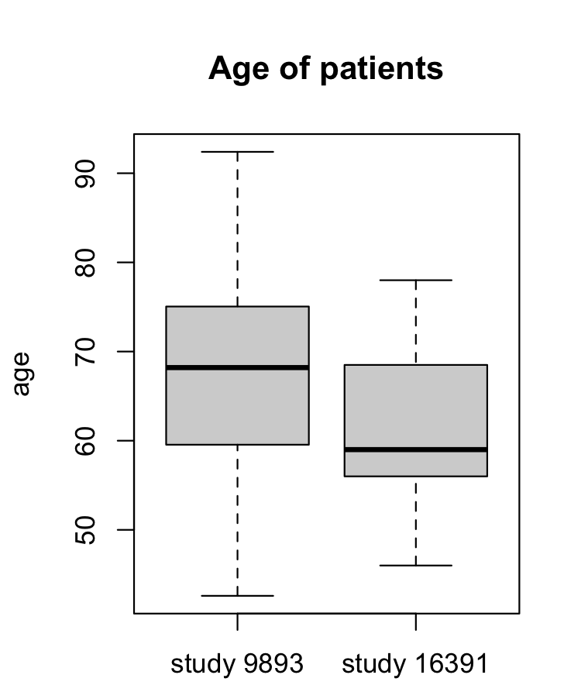
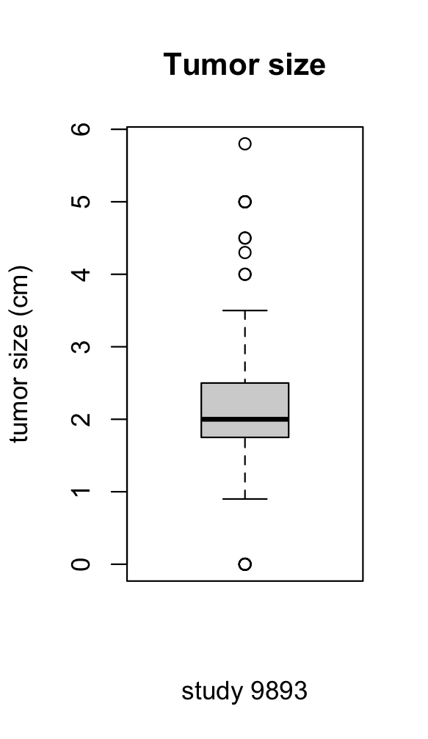
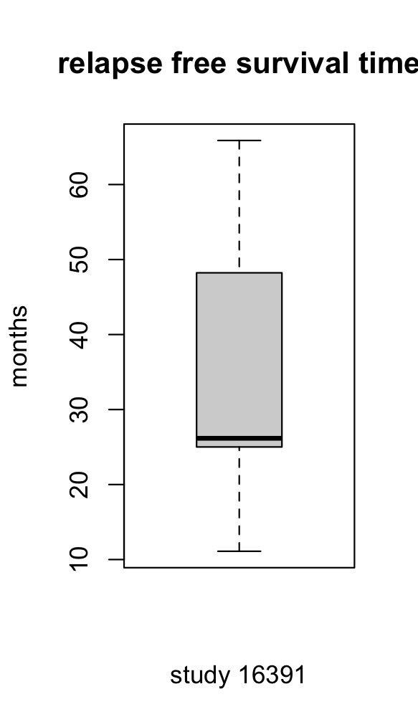
Data Summary: Clinical Table
 | GSE9893 | GSE16391 | Both studies
RFS 1 | 52 | 10 | 62
RFS 0 | 103 | 38 | 141
No chemo | 148 | 30 | 178
Chemotherapy | 0 | 18 | 18
No radio | 34 | 6 | 40
Radiotherapy | 114 | 42 | 156
PR- | 29 | 10 | 39
PR+ | 126 | 38 | 164
ER- | 8 | 0 | 8
ER+ | 147 | 48 | 195
Total sample size | 155 | 48 | 203

Slide 8
Data Summary: Microarray Data
Example:
Genes | Patient 1 | Patient 2 | … | Patient n
DDR1 | 9.327817 | 9.820844 | … | 9.481542
RFC2 | 7.691686 | 8.651933 | … | 8.030698
… | … | … | … | …
Study ID | GSE9893 | GSE16391
# of genes | 22,898 | 54,696
# of patients | 155 | 48
Min | 0.00000 | 2.24206
Median | 3.06429 | 3.12226
Max | 12.62928 | 16.14075

Slide 9
Methods

Slide 10
2x2 Contingency Tables
Fisher’s Exact Test (Odds Ratio and Relative Risks): to measure the strength of these associations, enabling reliable interpretations of the data
Chi-square test: to evaluate the association between two categorical variables
P-Values: Calculated for both OR and Chi-squared values to tell us whether our results are statistically significant.

Slide 11
Regression Analysis
We use Logistic regression to model with a binary outcome variable, the probability of dying from cancer. The predictor variables are the features we select because they are thought to be associated with the outcome.
Key Features
Age
Histology Grade
Estrogen Receptor Status (Pre-Treatment)
Radiotherapy
Chemotherapy
Tamoxifen
Hormonal Therapy (Aromatase Inhibitor)
Interaction between Histology Grade and Estrogen Receptor Status
We will create three data visuals. Logistic Regression Coefficients, ROC Curve and AUC Score, and Histogram of Predicted Probabilities
Notes:
gistic Regression Coefficients:
The model provided a set of coefficients for the predictor variables, which quantify the relationship between each predictor and the likelihood of the event (in this case, death from cancer).
Significant predictors (like histology grade) had coefficients that were distinctly different from zero, suggesting a strong relationship with the outcome.
Odds Ratios:
The Odds Ratios derived from the coefficients tell us about the strength of the association between each predictor and the outcome.
For instance, if the Odds Ratio for a treatment is above 1 and statistically significant, it means that treatment is associated with higher odds of survival. Conversely, an Odds Ratio below 1 would suggest a treatment is associated with lower odds of survival.
ROC Curve and AUC Score:
The ROC curve plotted during the analysis shows the trade-off between sensitivity (true positive rate) and specificity (false positive rate) at different thresholds.
The AUC score was 0.74, which suggests that the model has a good level of discrimination. In other words, it's quite good at distinguishing between patients who died and those who survived based on the predictors used in the model.
Histogram of Predicted Probabilities:
This histogram displays how the probabilities of the predicted outcome (death from cancer) are distributed across all patients.
A well-performing model would show a clear distinction between the probabilities for the two groups of patients (those who died and those who survived).

Slide 12
Microarray, False Discovery Rate
Split the patients into groups
RFS – 1, RFS – 0
Then further subset patients into groups depending on treatment status
Tamoxifen
Radiotherapy
Hormonal therapy
Performed a t-test to compare the microarray expression between patients with good and bad outcomes
FDR correction of p-values with cutoff of 0.05

Slide 13
Results
2x2 tables and Logistic Regression

Slide 14
2x2 Tables
Tamoxifen | Died | Alive | Total
- | 106 | 42 | 161
+ | 7 | 0 | 7
total | 113 | 42 | 155
Tamoxifen/ Chemo | Died | Alive | total
- | 89 | 113 | 161
+ | 1 | 0 | 1
total | 90 | 113 | 203
OR: 0.0 (p=0.1905), RR: 0.7162, CHI²: 1.4776 (p=0.2241)
OR: Inf (p=0.4461), RR: 2.2556, CHI²: 0.0118 (p=0.9134)
Tamoxifen/ Hormonal | Died | Alive | total
- | 35 | 7 | 42
+ | 55 | 106 | 161
total | 90 | 113 | 203
Tamoxifen/ Radio | Died | Alive | total
- | 50 | 30 | 80
+ | 40 | 83 | 123
total | 90 | 113 | 203
OR: 0.6515 (p=0.0529), RR: 0.7705, CHI²: 3.4646 (p=0.0627)
OR: 0.6051 (p=0.0364), RR: 0.7335, CHI²: 3.9801 (p=0.0460)

Slide 15
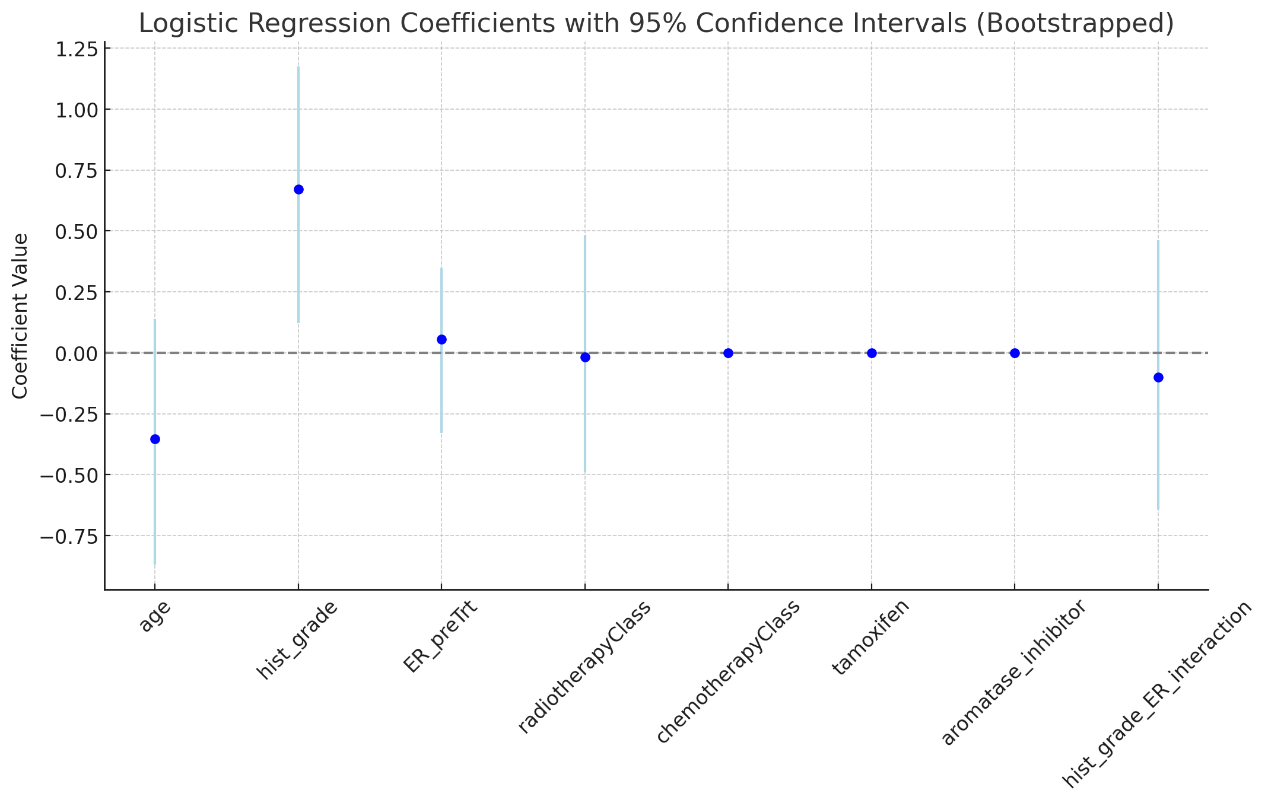
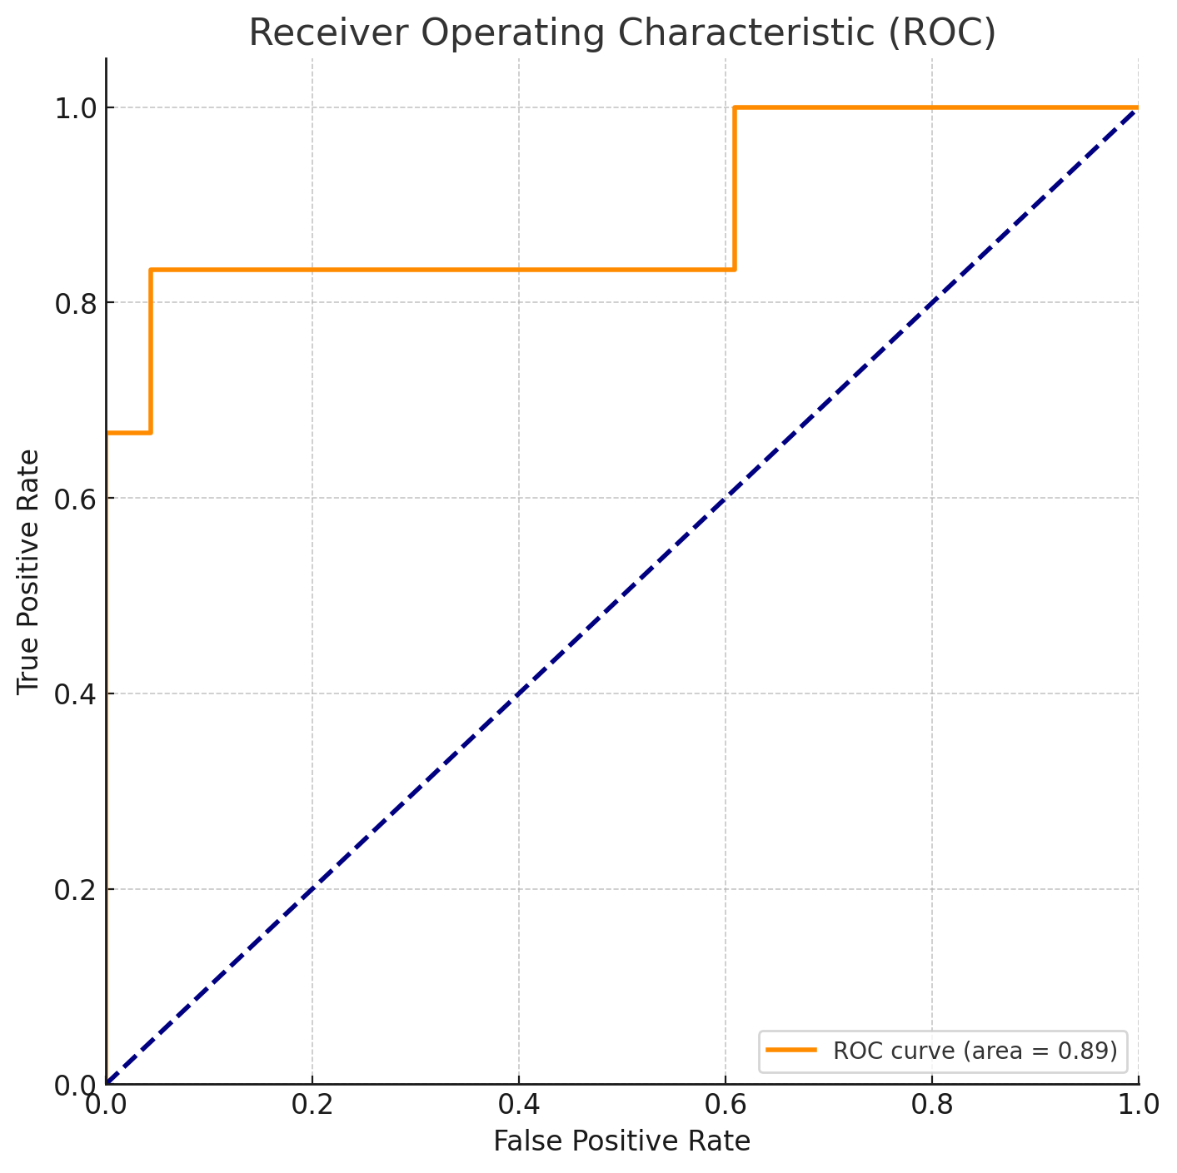
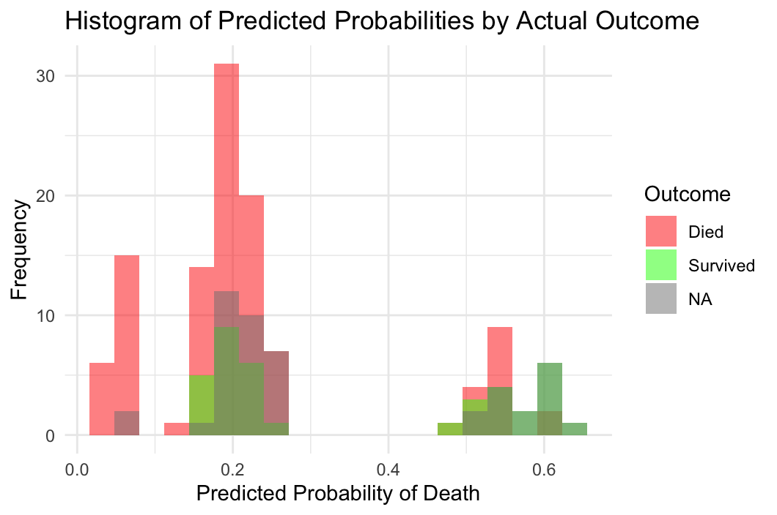
Logistic Regression

Slide 16
Discussion

Slide 17
2x2 Tables
Tamoxifen:
The analysis suggests that Tamoxifen alone does not significantly reduce mortality compared to no treatment, as indicated by the non-significant odds ratio and chi-square test.
Tamoxifen with Chemotherapy:
Despite the infinite odds ratio suggesting an extreme effect, the high p-values indicate that this combination does not provide statistically significant evidence of mortality reduction, likely affected by small sample sizes.
Tamoxifen with Hormonal Therapy:
This combination shows a trend towards effectiveness with a lower risk of dying for the treated group, though the results are not conclusively significant. This suggests potential benefits that warrant further investigation.
Tamoxifen with Radiotherapy:
Combining Tamoxifen with Radiotherapy significantly reduces mortality, as shown by significant values in both odds ratio and chi-square tests. This indicates that this combination is effective in reducing the risk of death.

Slide 18
Logistic Regression
Coefficients: A higher histology grade significantly increased the odds of dying from cancer, while older age was associated with a decreased risk. Treatments like radiotherapy appeared to reduce the likelihood of death, while chemotherapy and hormonal therapy appeared as 0, indicating no independent effect on the odds of death from cancer
ROC/AUC Curve: The AUC score was 0.74, which suggests that the model has a good level of discrimination. It is good at distinguishing between patients who died and those who survived based on the predictors used in the model.
Predicted Probability Histogram: The histogram reveals significant overlap in the predicted probabilities for patients who died and those who survived, suggesting the model struggles to differentiate effectively between outcomes. This indicates room for improvement which might involve adding more predictors, feature engineering, or considering different techniques to improve the model's predictive power.

Slide 19
Microarray Results & Discussion

Slide 20
Microarray Results: Relapse DEGs
GSE16391 - TOP 5 GENES
GSE9893 – TOP 5 GENES
RFS 0 vs. RFS 1
P<0.05:
GSE16391: 5808 genes
GSE9893: 14,045 genes
After FDR correction, p<0.05:
GSE16391: 134 genes
GSE9893: 13,082 genes
Common genes with FDR p<0.05:
40 genes
GENE NAME | FDR p-value
CENPBD1 | 0.0042
PAFAH2 | 0.0081
DUSP19 | 0.0087
ADORA3 | 0.0095
MTAP | 0.0096
GENE NAME | FDR p-value
NKIRAS1 | 2.09*10⁻⁸
YRDC | 2.768*10⁻⁸
CADPS | 2.767*10⁻⁸
CACNB2 | 4.88*10⁻⁸
MYO16 | 5.85*10⁻¹⁸
TOP 5 COMMON GENES
GENE NAME | GSE16391 P-VAL | GSE9893 P-VAL
ADORA3 | 0.0095 | 3.468*10⁻⁶
THUMPD3 | 0.0105 | 1.702*10⁻⁴
C9orf40 | 0.0113 | 4.660*10⁻⁵
MTAP | 0.0095 | 5.901*10⁻³
PAFAH2 | 0.0081 | 1.010*10⁻²

Slide 21
Microarray Results: RFS + Tamoxifen
GSE16391 - TOP 5 GENES
Tamoxifen + RFS 0 vs. Tamoxifen + RFS 1
P<0.05:
2950 genes
After FDR correction, p<0.05:
56 genes
GENE NAME | P-VALUE | FDR CORRECTED
LGI2 | 1.298*10⁻¹⁹ | 7.103*10⁻¹⁵
HIST1H2BJ | 3.611*10⁻¹⁵ | 9.874*10⁻¹¹
RANBP3L | 1.276*10⁻¹³ | 2.326*10⁻⁹
RBP2 | 2.568*10⁻¹² | 2.809*10⁻⁸
ACSM3 | 5.373*10⁻¹² | 4.198*10⁻⁸

Slide 22
Microarray Results: RFS - Tamoxifen + radiotherapy
GSE9893 – TOP 5 GENES
Treatment: tamoxifen + radiotherapy, relapse of 0 vs 1.
P<0.05:
GSE16391: 3141 genes
GSE9893: 6796 genes
After FDR correction, p<0.05:
GSE16391: 806 genes
GSE9893: 67 genes
Common genes with FDR p<0.05:
1 gene: ABCC3
GENE NAME | FDR p-value
IGKV1-9 | 1.439*10⁻⁹
GDPD2 | 2.225*10⁻⁴
TRB@ | 1.163*10⁻³
FCGBP | 2.000*10⁻³
B4GALNT1 | 1.498*10⁻³
GSE16391 - TOP 5 GENES
GENE NAME | FDR p-value
PPARA | 3.004*10⁻²⁴
CRB1 | 5.529*10⁻²³
SG3BO2 | 5.287*10⁻²³
PRG2 | 7.853*10⁻²¹
MYO7A | 1.871*10⁻¹⁸

Slide 23
Microarray Results: RFS - Tamoxifen + hormonal therapy
GSE9893 – TOP 5 GENES
GENE NAME | FDR p-value
IGKV1-9 | 1.330*10⁻¹¹
TRB@ | 1.701*10⁻⁴
GDPD2 | 2.737*10⁻⁴
FCGBP | 1.502*10⁻³
TRPV2 | 1.178*10⁻²
Treatment: tamoxifen + hormonal therapy, relapse of 0 vs 1.
P<0.05:
GSE16391: 2135 genes
GSE9893: 7423 genes
After FDR correction, p<0.05:
GSE16391: 645 genes
GSE9893: 315 genes
Common genes with FDR p<0.05:
2 genes: ABCC3, TUSC3
GSE16391 - TOP 5 GENES
GENE NAME | FDR p-value
ACADL | 7.070*10⁻⁵³
SYNPO2 | 8.418*10⁻³⁷
SHISA3 | 1.012*10⁻³⁰
FCRLA | 1.974*10⁻²⁹
RFXAP | 2.141*10⁻²⁶

Slide 24
Microarray: Significant Genes
Which genes are significantly associated with relapse free survival of breast cancer patients regardless of treatment?
Genes involved with DNA damage response and DNA repair
BTG2, PARPBP, USP10, RAD18, SMC6, YRDC
NFKB inhibitor interacting Ras like 1 (NKIRAS1)
Tumor-suppressor gene
Adenosine A3 receptor (ADORA3)
inflammation and cell proliferation
Platelet activating factor acetylhydrolase 2 (PAFAH2)
Inflammation, blood coagulation
Notes:
BTG2 – BTG anti-proliferation factor 2. DNA repair response signaling
PARPBP -- PARP1 binding protein. Ds DNA repair
USP10 – ubiquitin specific peptidase 10. DNA repair, response to DNA damage, autophagy.
RAD18 – RAD18 E3 ubiquitin rotein ligase. DNA repair, response to DNA damage stimulus
SMC 6 – structural maintenance of chromosomes 6. dsDNA break repair through homologous recombination, telomere maintenance.
YRDC – genomic stability. Regulates accurate protein synthesis.

Slide 25
Microarray: Significant Genes
Which genes are significantly associated with relapse free survival outcomes in ER+ breast cancer patients receiving tamoxifen treatment?
Genes involved with cell metabolic processes
Leucine rich repeat LGI family member 2 (LGI2)
Cellular processes, biogenesis
SLC39A8, SLC25A21 - Transporters
Tamoxifen acts by competing with the estrogen receptor to slow cell cycle
Some tumors may bypass cell cycle through other pathways, or metabolize tamoxifen too quickly for it to be effective
Notes:
ACSM3 – acyl-CoA synthetase medium chain family member 3. metabolism and cellular process (lipid, carboxylic acid, organic acid, fatty acid, cofactors, sterol)
AKT2 – AKT serine threonine kinase 2. basically everything metabolism.
PNPLA3 – patatin like phospholipase domain containing 3. metabolism (fatty acid, lipids, glycerol, triglyceride, phospholipids, homeostasis)
SLC25A21 – solute carrier family 25 member 2. metabolism and transport. Carboxylic acid and transport.
SLC39A8 – solute carrier family 39 member 8. ion transport. Metal ions.
PPARA -- peroxisome proliferator activated receptor alpha. Regulation of cell growth, hypoxia response, metabolic process, biosynthesis. Basically everything
GLS – glutaminase. Catabolism. Gaseous exchange. Regulation of homeostasis, metabolism. Amino acid metabolism.

Slide 26
Microarray: Significant Genes
Which genes are significantly associated with relapse free survival outcomes in ER+ breast cancer patients receiving tamoxifen treatment AND radiotherapy?
ABCC3 gene identified as significant in both datasets
Organic ion transporter 3
Strongly associated with multidrug resistance in multiple cancers
T cell receptor beta locus (TRB@)
Certain T-cell recombinants are associated with T-cell mediated cancer cytotoxicity

Slide 27
Microarray: Significant Genes
Which genes are significantly associated with relapse free survival outcomes in ER+ breast cancer patients receiving tamoxifen treatment AND hormonal therapy?
T cell receptor beta locus (TRB@) again!
Tumor suppressor candidate 3 (TUSC3)
Low TUSC3 levels significantly associated with cell proliferation and aggressive phenotype of cervical cancer
Promotes metastasis
Associated with poor prognosis in cancer patients
Rho GDP dissociation inhibitor 2 (GDPD2)
Metastasis suppressor in cancer
GDPD2 mutations decrease its ability to inhibit metastasis

Slide 28
Conclusions

Slide 29
Conclusion
Tamoxifen is recommended for patients with ER+ breast cancer along with radiotherapy.
For patients that are unable to have radiotherapy, other newer drugs have been developed that have similar or better efficacy
Aromatase inhibitors
Toremifene, anastrozole
Importance of screening patients for type of cancer prior to prescribing treatment
Measure levels of ABCC3, TUSC3, other genes to identify aggressive cancers that may not respond well to tamoxifen
Screen for cancers at high risk of metastasis
Notes:
Tamoxifen alone can increase risk of uterine cancer due to mimicking estrogen in the body outside of the tumor
Used in post-menopausal women with ER+ breast cancer
Minimally invasive treatment (taken orally daily) for patients at high risk for devolping breast cancer

Slide 30
Thank you!

Slide 31
References
Planey K (2023). curatedBreastData: Curated breast cancer gene expression data with survival and treatment information. doi:10.18129/B9.bioc.curatedBreastData https://doi.org/10.18129/B9.bioc.curatedBreastData, R package version 2.30.0, https://bioconductor.org/packages/curatedBreastData.
Desmedt, C., Giobbie-Hurder, A., Neven, P., Paridaens, R., Christiaens, M. R., Smeets, A., Lallemand, F., Haibe-Kains, B., Viale, G., Gelber, R. D., Piccart, M., & Sotiriou, C. (2009). The Gene expression Grade Index: a potential predictor of relapse for endocrine-treated breast cancer patients in the BIG 1-98 trial. BMC medical genomics, 2, 40. https://doi.org/10.1186/1755-8794-2-40
Chanrion, M., Negre, V., Fontaine, H., Salvetat, N., Bibeau, F., Mac Grogan, G., Mauriac, L., Katsaros, D., Molina, F., Theillet, C., & Darbon, J. M. (2008). A gene expression signature that can predict the recurrence of tamoxifen-treated primary breast cancer. Clinical cancer research : an official journal of the American Association for Cancer Research, 14(6), 1744–1752. https://doi.org/10.1158/1078-0432.CCR-07-1833
Tavčar Kunstič, T., Debeljak, N., & Fon Tacer, K. (2023). Heterogeneity in hormone-dependent breast cancer and therapy: Steroid hormones, HER2, melanoma antigens, and cannabinoid receptors. Advances in Cancer Biology - Metastasis, 7, 100086. https://doi.org/10.1016/j.adcanc.2022.100086
B.T. Sherman, M. Hao, J. Qiu, X. Jiao, M.W. Baseler, H.C. Lane, T. Imamichi and W. Chang. DAVID: a web server for functional enrichment analysis and functional annotation of gene lists (2021 update). Nucleic Acids Research. 23 March 2022. doi:10.1093/nar/gkac194.
Huang DW, Sherman BT, Lempicki RA. Systematic and integrative analysis of large gene lists using DAVID Bioinformatics Resources. Nature Protoc. 2009;4(1):44-57.
Farrar MC, Jacobs TF. Tamoxifen. [Updated 2023 Apr 10]. In: StatPearls [Internet]. Treasure Island (FL): StatPearls Publishing; 2024 Jan-. Available from: https://www.ncbi.nlm.nih.gov/books/NBK532905/
Zhou WB, Ding Q, Chen L, Liu XA, Wang S. Toremifene is an effective and safe alternative to tamoxifen in adjuvant endocrine therapy for breast cancer: results of four randomized trials. Breast Cancer Res Treat. 2011;128(3):625-631. doi:10.1007/s10549-011-1556-5
Ramírez-Cosmes, A., Reyes-Jiménez, E., Zertuche-Martínez, C., Hernández-Hernández, C. A., García-Román, R., Romero-Díaz, R. I., Manuel-Martínez, A. E., Elizarrarás-Rivas, J., & Vásquez-Garzón, V. R. (2021). The implications of ABCC3 in cancer drug resistance: can we use it as a therapeutic target?. American journal of cancer research, 11(9), 4127–4140.
Crowther MD, Dolton G, Legut M, et al. Genome-wide CRISPR-Cas9 screening reveals ubiquitous T cell cancer targeting via the monomorphic MHC class I-related protein MR1 [published correction appears in Nat Immunol. 2020 Mar 2;:]. Nat Immunol. 2020;21(2):178-185. doi:10.1038/s41590-019-0578-8
Moissoglu K, McRoberts KS, Meier JA, Theodorescu D, Schwartz MA. Rho GDP dissociation inhibitor 2 suppresses metastasis via unconventional regulation of RhoGTPases. Cancer Res. 2009;69(7):2838-2844. doi:10.1158/0008-5472.CAN-08-1397

